Slide 1


$ whoami
Mayur Waghmode
DevOps Engineer 2 at Teradata
Certified Kubernetes Administrator
Aws Certified Solution Architect Associate
Area Director D5 - D125 Toastmasters International

Slide 2


Slide 3


Slide 4


Slide 5
Chaos engineering is the discipline of experimenting on a system in order to build confidence in the system's capability to withsatnd turbulent conditions in production

Slide 6
Chaos Engineering Principles
Define steady state
2. Hypothesize about the Steady State
3. Introduce real-world events
4. Verify steady state and validate hypothesis

Slide 7

Chaos Engineering Tools

Slide 8

Injecting Faults
Breaking things on purpose to make them stronger

Slide 9

When Everything Goes Wrong
When the unexpected happens, chaos engineering helps us prepare

Slide 10

Learning from Chaos
Every failure is a learning opportunity

Slide 11

Watching Closely
Keeping an eye on our systems to spot issues before they become problems

Slide 12
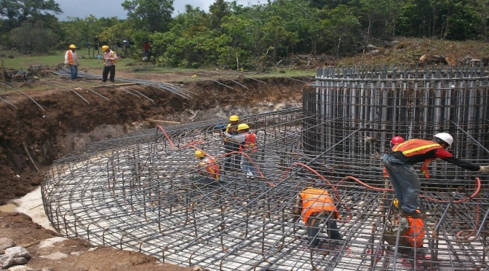
Building Resilient Systems
Chaos engineering helps us build systems that can withstand anything

Slide 13
References
https://v1-docs.litmuschaos.io/docs/getstarted
https://docs.litmuschaos.io/docs/getting-started/installation
https://www.gremlin.com/community/tutorials/chaos-engineering-the-history-principles-and-practice
https://github.com/litmuschaos/litmus/tree/master/chaoscenter

Slide 14

Q & A

Slide 15


THANKS :)

